Slide 1


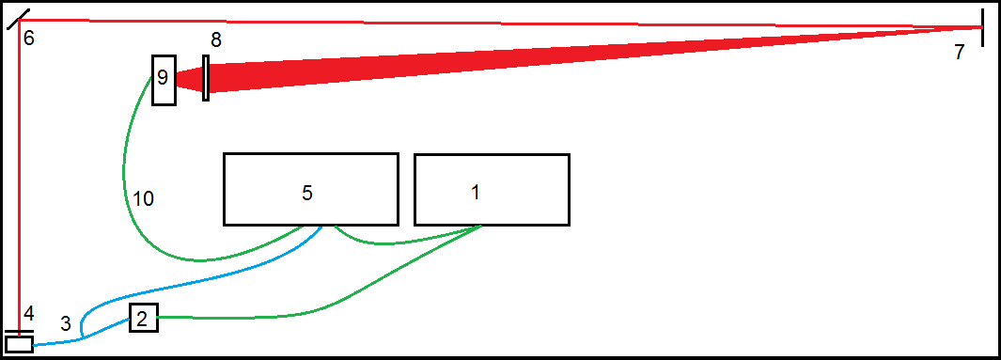
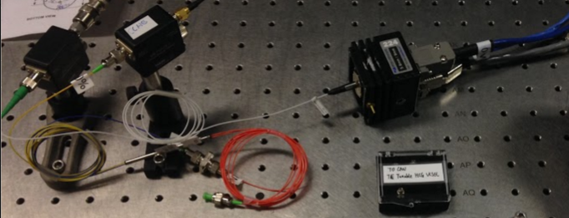
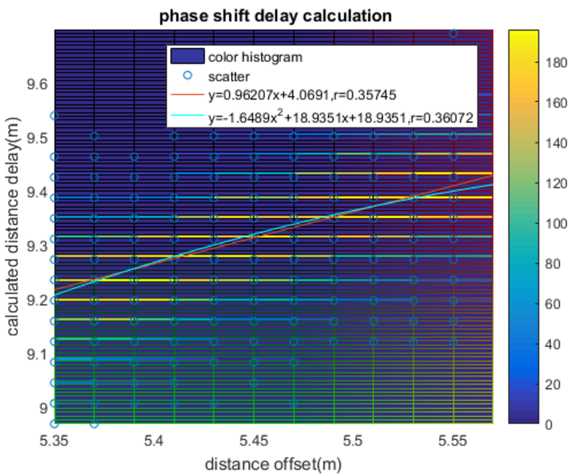
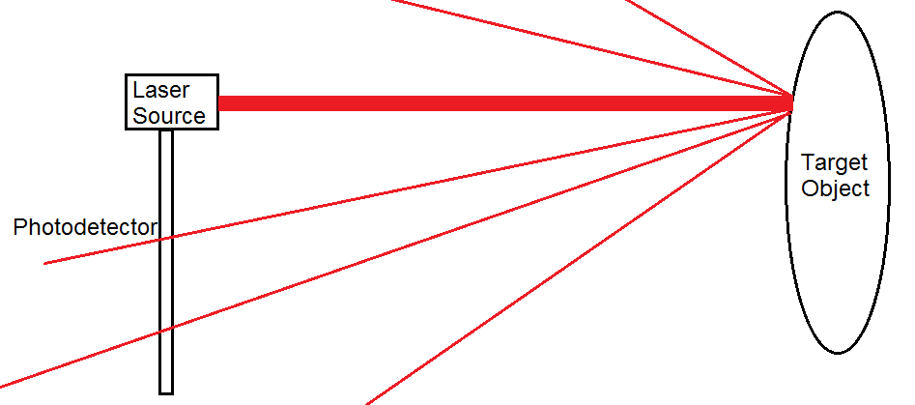
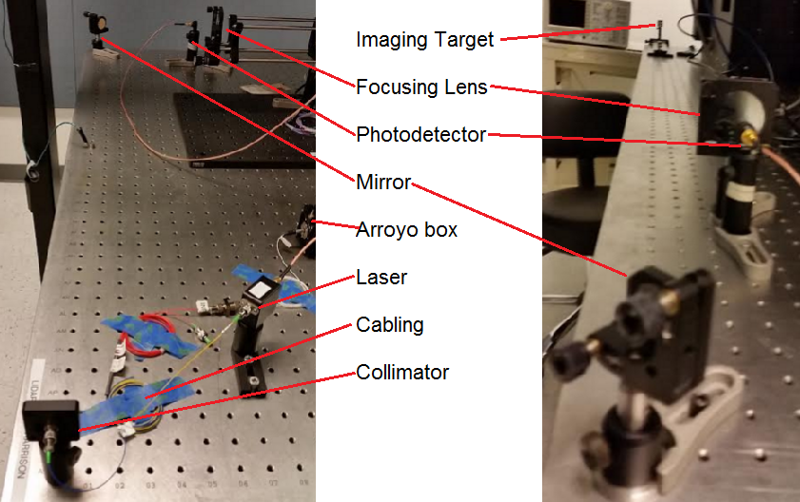
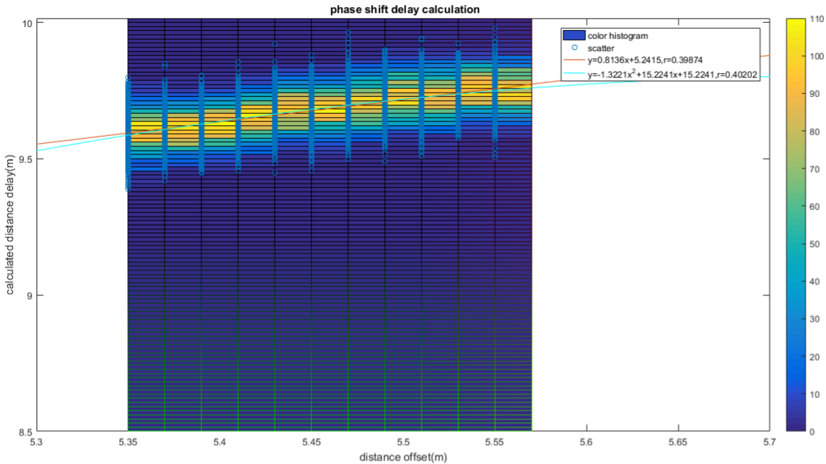
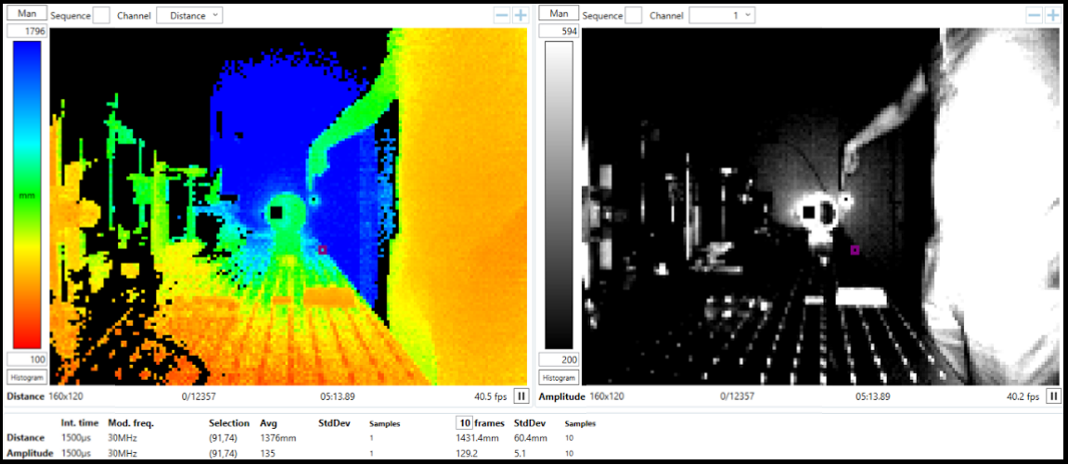
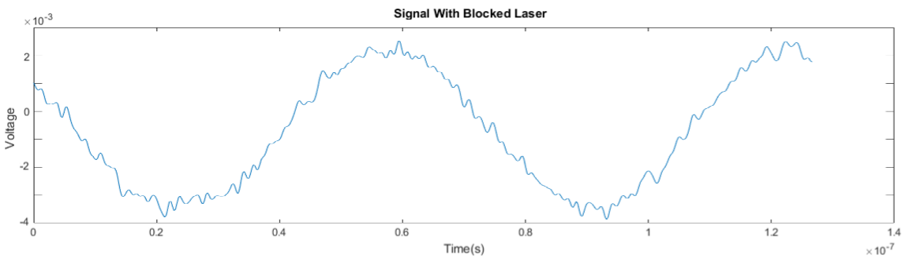
Time-of-Flight LIDAR System
Investigators: Vy-An Phan, Harrison Hsueh, Adair Gerke, Kun Li
UC Berkeley, Dr. Connie Chang-Hasnain
Center for Integrated Access Networks: Creating transformative optical technologies to enable an affordable faster internet for the future.
University of Arizona | Columbia University | Norfolk State University | Tuskegee | UC Berkeley | UC San Diego | University of Southern California
Problem Statement
Methods
Results
The goal is the creation of a fast and accurate time-of-flight LIDAR system, specifically, a one-dimensional distance imager.
We took a series of measurements between distances of 527 and 555 cm at 1-cm intervals (2cm when including round trip of rebounded signal).
The ideal result of graphing real versus calculated distance would be a line of slope 1. A constant error due to delay in the wires would manifest as a nonzero y-intercept, and can be easily taken care of through subtraction.
In reality, the calculated time delay, and thus the calculated distance, varied depending on the method used to extract the time delay.
After testing the range and accuracy of the Bluetechnix market camera, we moved on to our freespace LIDAR design.
Experimental setup: We measured time delay versus that of a known reference distance, rather than raw distance, to account for variable delay in the electrical wires and other cabling. The laser path is shown in red, fiber-optic cabling is shown in blue, and electrical wiring in green.
(1) An HP 33120A function generator is set to a sine wave of frequency 15 MHz and fed to (2) a TO-CAN mounted 1050nm laser. The laser output is connected to a (3) 90%-10% split cable, connected to (4) a collimator and the (5) oscilloscope respectively.
The sync of the (1) function generator is also connected to the oscilloscope. Meanwhile, the (4) collimator is the start of the free-space part of our freespace laser system.
A (6) mirror deflects the beam around the edge of the table at the (7) imaging target.
The reflected beam is focused through a (8) lens before being received by a (9) SM05PD5A photodetector, whose output is received by the (1) oscilloscope through (10) more electric cabling.
Not pictured: Keithley, HP 6237B triple output power supply
Background
LIDAR systems operate by emitting a beam of light at a desired target and using the backscattered light to image said target.
Time-of-flight LIDAR systems keep track of the elapsed time between emitting and detecting a light beam. Most will also have a known time to correspond to a known distance for calibration purposes.
Since the speed of light is mostly constant in air, the time difference can be used to calculate distance to high accuracy.
For example, a raw threshold (top graph) provided more accurate, but less precise results. These measurements were also limited to discrete values.
Meanwhile, using DFT sine fitting (bottom graph) yielded less spread among measurements but a poor real:calculated distance ratio.
This is discussed further in the analysis section.
Purpose
LIDAR systems are incredibly useful in modern applications because of their sharpness in comparison to RADAR.
Our target performance will be based on the range and accuracy of the current LED market imager (Bluetechnix Argos3D P100), which sits at approximately 5m maximum range and delivers distance reports with a 1-40% range of error.
Below: distance and amplitude of a mirrored surface as seen by the Bluetechnix camera.
Analysis
Conclusions
When the laser was completely covered, we still received a small sinusoidal signal instead of a zeroed line (below).
This contributed to an extra phase change of our received signal that skewed the real:calculated distance ratio discussed in the Results section.
To improve the accuracy of the sine fitting, we will need to subtract out any residual echo before performing phase delay calculations.
This can be achieved by collecting samples of the echo during calibration (i.e. any signals occurring when the laser is covered) and negating it. More work will have to be done to determine the source of the echo and clean it out with greater accuracy.
Acknowledgements
The authors would like to acknowledge support from: Dr. Connie Chang-Hasnain, Thai-Bao Phan, and the National Science Foundation through CIAN grant #EEC-0812072..

